Slide 1

MARKETING Strategy

Slide 2

Team Lead Wayne Joslee
Business Analyst

Slide 3
Agenda
Primary goal
Data Overview
Market Analysis
Marketing Strategy
Limitations

Slide 4
Our Goal
Increase profitability for Lakeside Market, with a secondary aim of narrowing the performance gap with our competitors.
We currently have an Estimated All Commodity Volume of 39.95 million
Compared to our competitor with 71.45 million
Focus on leveraging promotions more effectively to target customers

Slide 5
Data Overview
Combined 6 data files
BeerEnvECPF2009.xlsx: Detailed customer-level purchases.
beer_PANEL_GK_1531_1582.dat: Store-level sales & promotions.
trips9 may13.csv: Trips with total basket cost. (not just beer)
ads demos9.csv: Household demographics.
prod11_beer.xlsx: Beer product catalog.
IRI week translation_2008_2017.xls: Week date mapping.
Handled missing and nan values
Feature Engineering
Log price transformation. (LOG_PRICE_OZ = log(PRICE_PER_OZ))
Adstock promotions: Smooth promotion effects across weeks.
Seasonality: Group weeks into seasonal bins.
Interactions: LOYALTY_SHARE * PRICE_PER_OZ (are loyal customers less price-sensitive?).
Promo intensity: FEATURE + DISPLAY + PRICE_REDUCTION as an aggregated "promo_score".
Customer loyalty: ratio of beer trips to total trips (lagged variable).

Slide 6
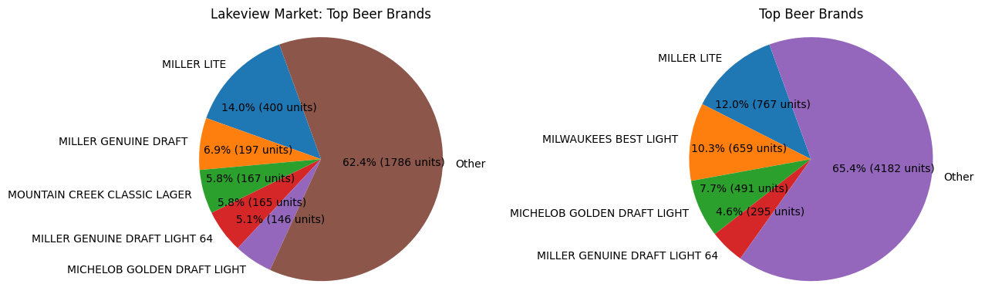
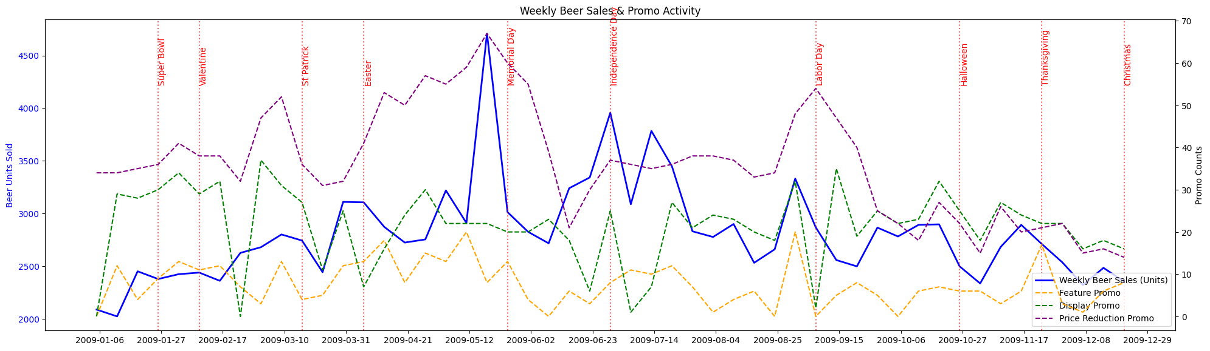
Who Shops With Us
Total unique customers: 332
Total trips made by customers: 11,225
Total beers purchased: 6,394

Slide 7
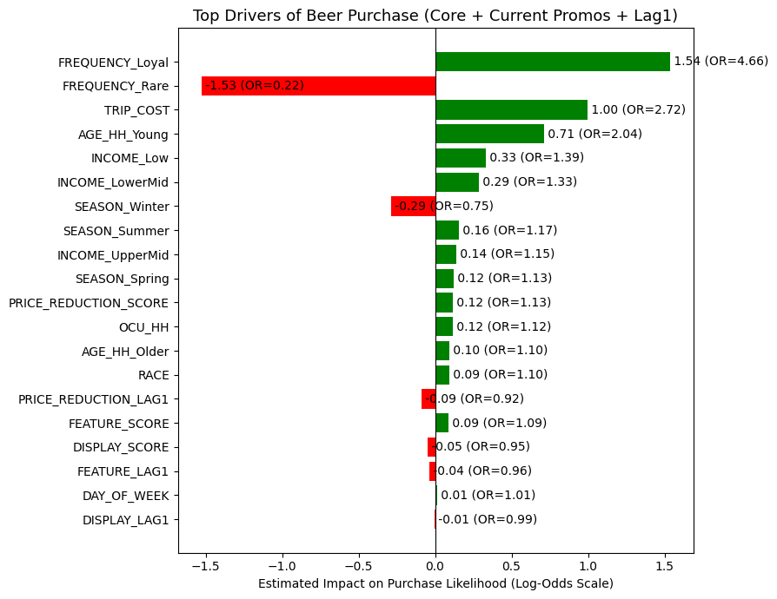
Purchase incidence model
What lifts trips?
Feature and Price reduction are positive; Display is slightly negative.
Promo fatigue?
Lag terms are negative; avoid back-to-back promo weeks; add a cool-off week.
Who buys?
Loyal customers and higher trip cost are strong positives; winter reduces beer drive.

Slide 8
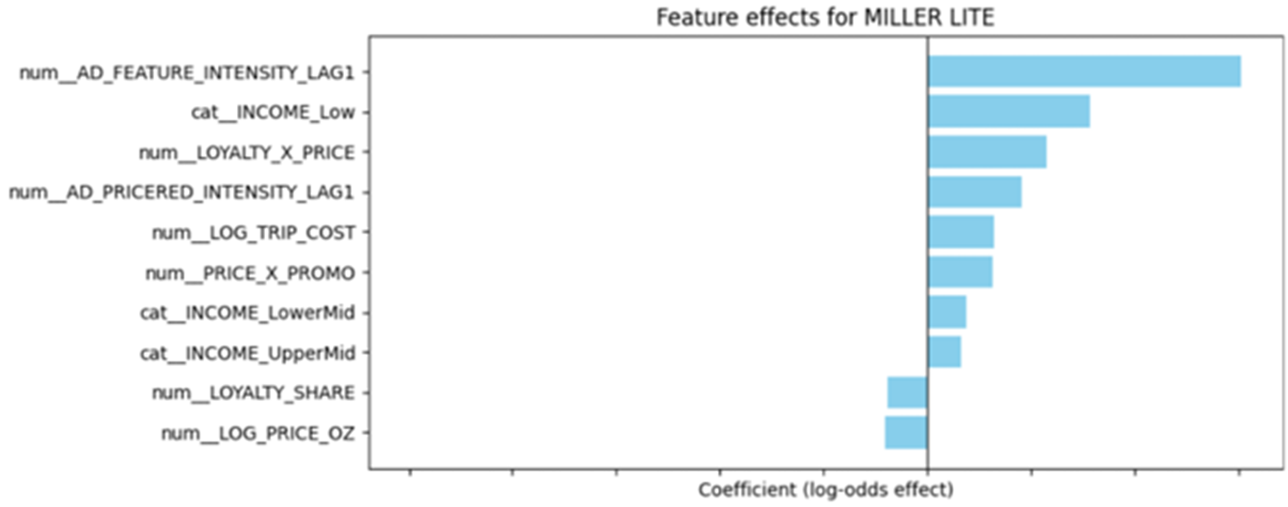
Brand choice model
Miller Lite
Promotions: Very responsive to promotional support.
Loyalty: not as repeat-driven.
Price: Lower prices improve appeal.

Slide 9
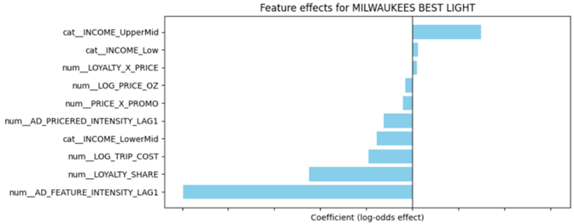
Brand choice model
Milwaukee’s Best Light
Promotions: features don’t help. Price reductions weak.
Loyalty: low brand stickiness.
Price: Not very price-driven.

Slide 10
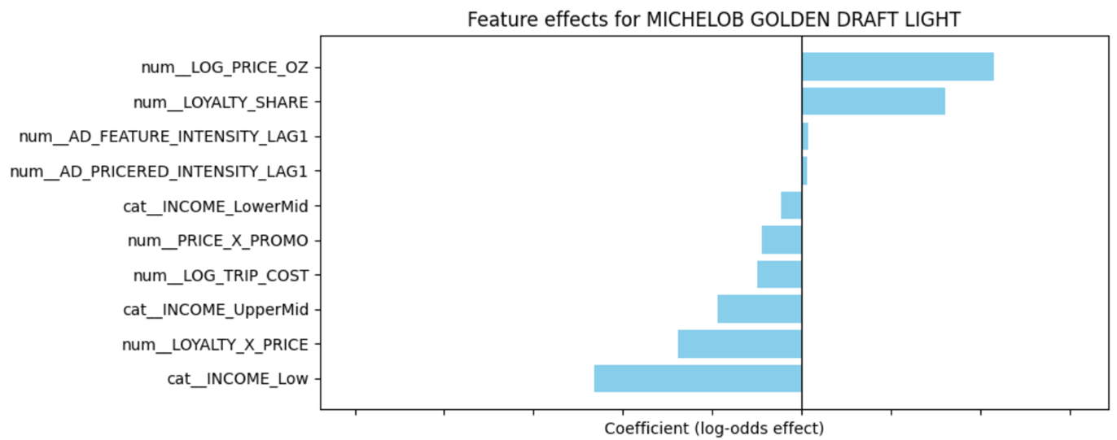
Brand choice model
Michelob Golden Draft Light
Price sensitivity: Customers buying this brand tend to pay more per ounce → positioned as a premium niche.
Loyalty: repeat purchase drives choice.
Promotions: Promotions help a little but not the main driver.

Slide 11
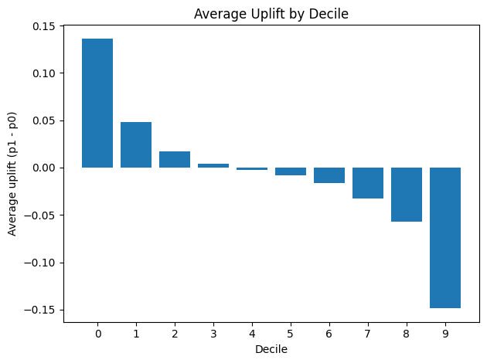
Uplift model
Treatment: weeks where the store ran both feature and price reduction promo.
Cutoff: target the top ~30%
Most of your incremental purchases live in the top 10–30%
Must-target: Decile 0.
Good add-ons (budget allowing): Decile 1, then 2.

Slide 12
Marketing Strategy

Slide 13
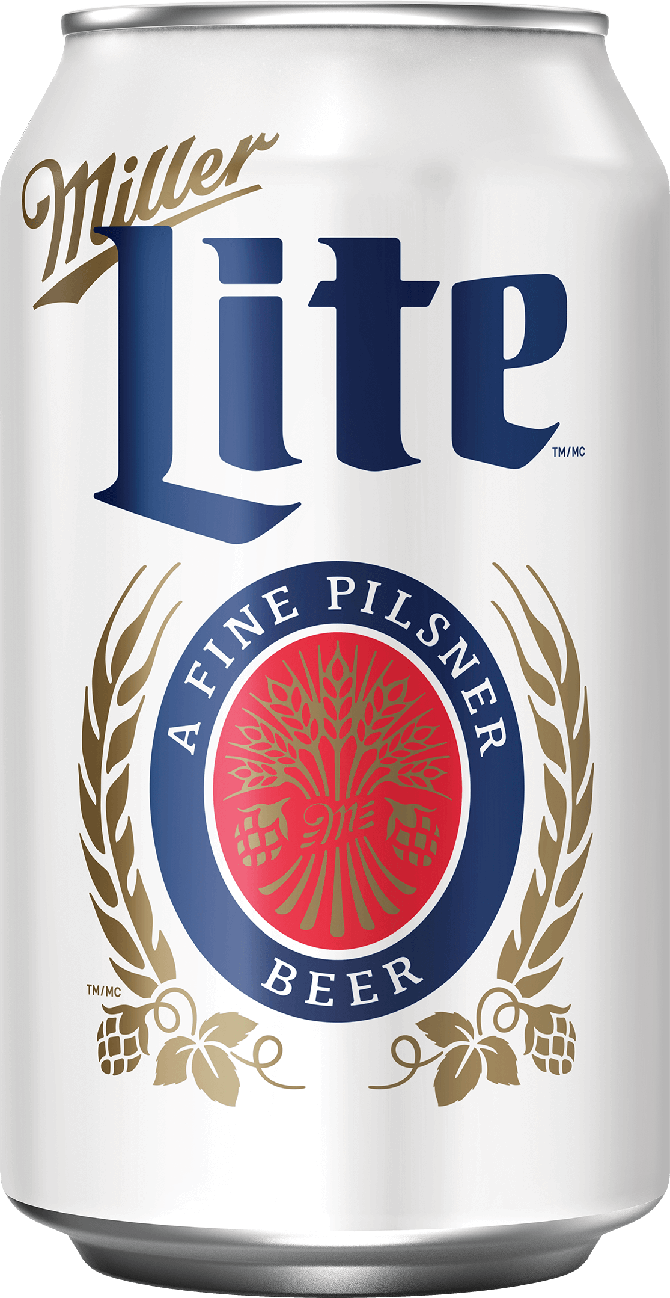
Miller Lite
Growth & Promo-Responsive
High Traffic weeks
Low Traffic weeks
Run features on high-traffic weeks only.
Add small discounts (−1% to −3%) on those feature weeks.
Hold base price (loyal buyers are less price-sensitive).
Avoid over-promotion: build in 1 cool-off week after a feature.
Marketing angle: angle: “Featured this week—grab Miller Lite” + light incentive or bundle.
13

Slide 14
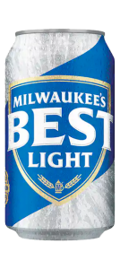
Milwaukee’s Best Light
Value Segment
Advertising hurts (feature coefficient negative) → avoid feature ads.
Quiet discounts (−1% to −2%) work; stick to simple price messaging.
Target value-sensitive shoppers; no need to spend on features/displays.
Marketing angle: “Value pick this week—Milwaukee’s Best Light.”
14

Slide 15
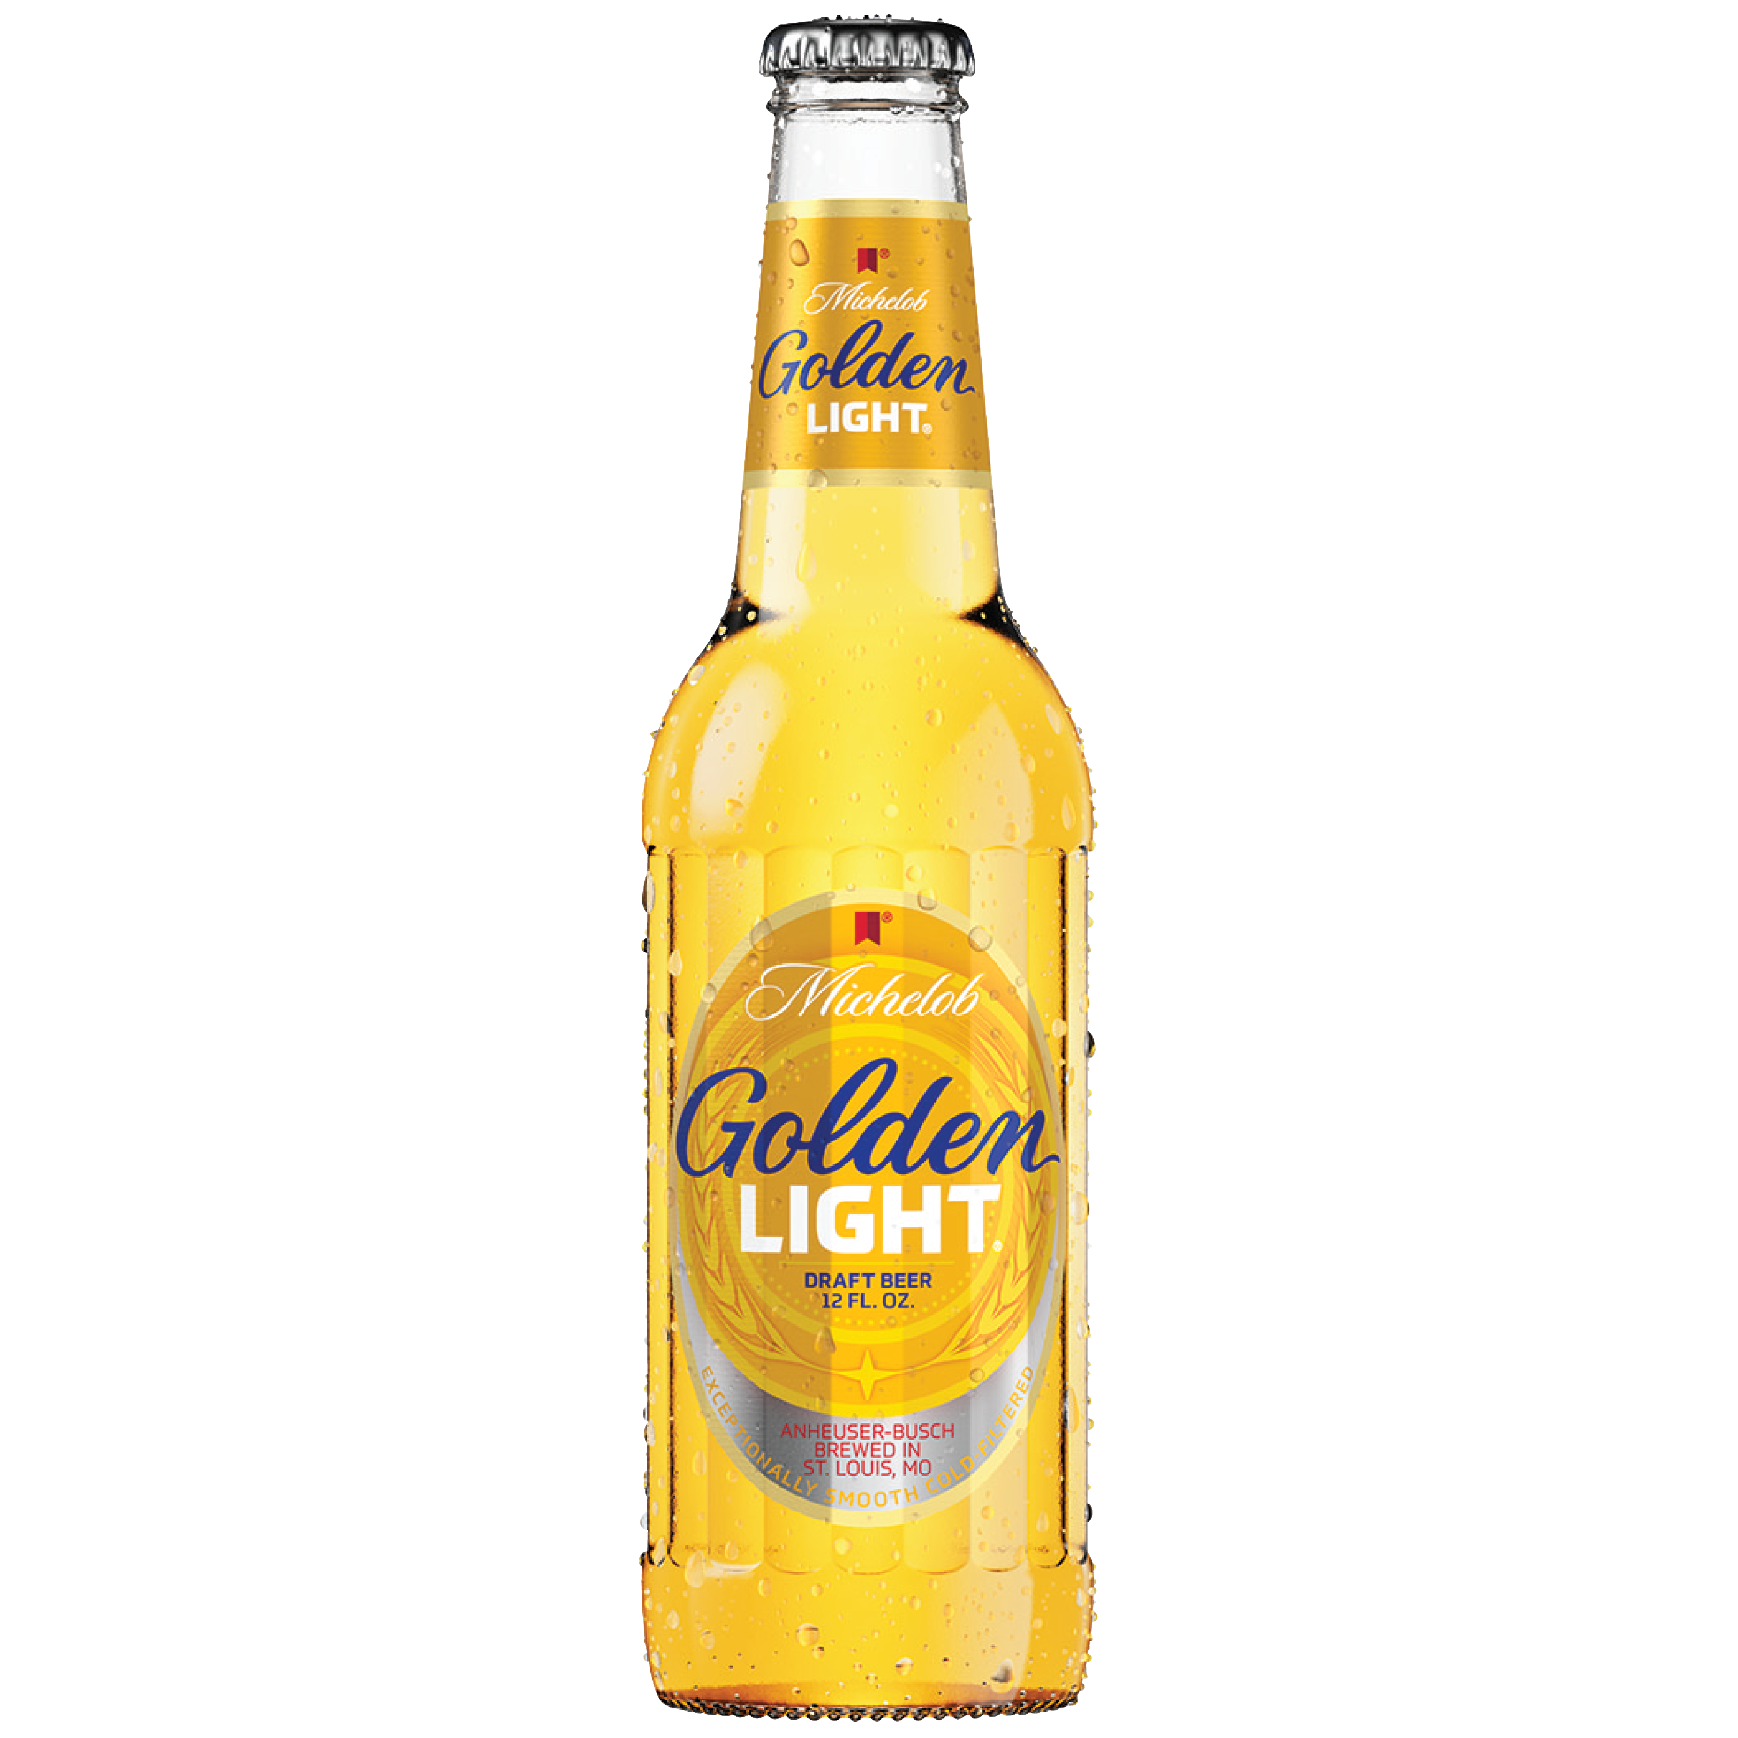
Michelob Golden Draft Light
Premium Positioning
Off-promo: Raise price by ~+2%. Coefficients show positive price effect (premium signal).
On feature weeks: Keep price flat or even a modest −1% discount.– Avoid raising price when featured.
Modest feature intensity is fine, but avoid deep discounts
Marketing angle: “Back in stock / Seasonal pick—Michelob Golden Draft Light.”
15

Slide 16
Targeting Plan
Who to target (audience)
Target share: 30% of customers
Count: 126 PANIDs
When to target (schedule)
~16 contact-only weeks in 2010
Best send days: Thu–Fri,
Seasonality: emphasize Spring/Summer, avoid heavy Winter
Contact cadence
1 email at week start (Mon/Tue), reminder Thu for decile 0 only (highest uplift)
Frequency cap: ≤ 2 emails/week per PANID; skip if the customer already purchased beer that week.
Cost
Contact cost: $0.03/email × 126 = $3.78/week + 50/week (for postcard coupons)
Margin rate: 25%
16

Slide 17
Potential profit
Brand | 2010 Revenue ($) | Margin + PROMO ($) | 2010 Profit ($)
Miller Lite | 185,698.36 | 46,424.59 121.86 | 46,302.73
Milwaukee’s Best Light | 29,654.29 | 7,413.57 + 19.46 | 28,923.48
Michelob Golden Draft Light | 115,998.40 | 28,999.60 + 76.12 | 7,394.11
Others | 979,858.29 | 327,802.34 + 860.48 | 244,321.54
 | 2009 (per annum) | 2010 (per annum)
Revenue | $1,303,145.70 | $1,311,209.34
Margin + Promo Cost | $325,786.43 + $2,550.00 | $327,802.34 + $860.48
Profit | $323,236.43 | $326,941.86
% increase in profit = +1.15%

Slide 18
Limitations
Analysis based on historical data — may not fully capture future market dynamics.
Assumes stable consumer preferences; unexpected shifts could alter results.
External factors (competitor actions, economic changes) not fully accounted for.
Cost Assumption: COGS and PROMO cost was assumed
Assuming Promotion contact cost: $0.03/email + 50/week
Assuming COGS at 75% considering - Purchase Cost, Inbound Freight and Handling, Duties and Import Taxes, Packaging, Labor, Licensing and Compliance Fees

Slide 19
THANK YOU

Slide 20
sources
Guadagni, P. M., & Little, J. D. C. (1983). A logit model of brand choice calibrated on scanner data. Marketing Science, 2(3), 203–238.
Gupta, S. (1988). Impact of Sales Promotions on When, What, and How Much to Buy. Journal of Marketing Research, 25(4), 342–355.
Uplift modelling – Wikipedia
[1911.08729] Response Transformation and Profit Decomposition for Revenue Uplift Modeling
What U.S. Data Should be Used to Measure the Price Elasticity of Demand for Alcohol?
https://goodwoodpub.com/index.php/ijfam/article/download/81/20/100?

Slide 21
Appendix
Category | Period / Event | Observed Pattern
Historically High-Purchase Weeks | Super Bowl (Late Jan / Early Feb) | Noticeable sales bump
 | Memorial Day (Late May) | Biggest spike of the year
 | Independence Day (Early July) | Strong sales
 | Labor Day (Early September) | Strong sales
 | Christmas / New Year (Late December) | Noticeable increase
Other High-Purchase Weeks | Late March | Likely NCAA March Madness / spring promotions
 | Mid–Late August | Summer-end sales surge
Low-Purchase Weeks | Early January | Post-holiday slump
 | Mid-April | Post-Easter dip
 | Late October | Pre-Halloween slump despite promotions
 | Early November | Before Thanksgiving build-up
21

